Slide 1
NYCU DLP
Lab5 - Conditional VAE for Video Prediction
謝宏笙
April 19, 2022

Slide 2
Outline
Lab Objective
Important Date
Lab Description
Scoring Criteria
Implement Hints

Slide 3
Lab Objective
In this lab, you need to implement a conditional Variational Autoencoder (VAE) for video prediction.
Example:

Slide 4
Important Date
Report Submission Deadline: 5/10 (Tue.) 11:59 a.m.
Demo date: 5/10 (Tue.)
Zip all files into one file
Report (.pdf)
Source code
Name it like「DLP_LAB5_yourstudentID_name.zip」
ex: 「DLP_LAB5_310551109_謝宏笙.zip」

Slide 5
Lab Description
Variational Autoencoder
Reparameterization Trick
Overall architecture
KL Cost Annealing
Dataset

Slide 6
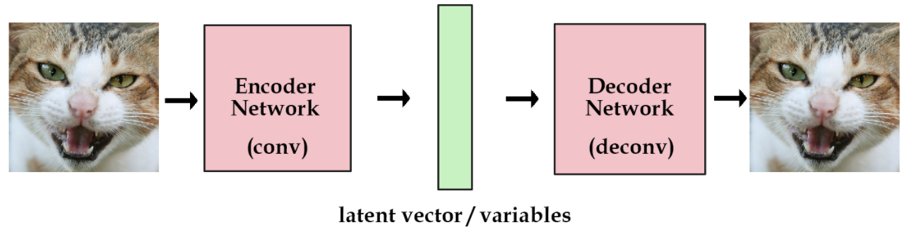
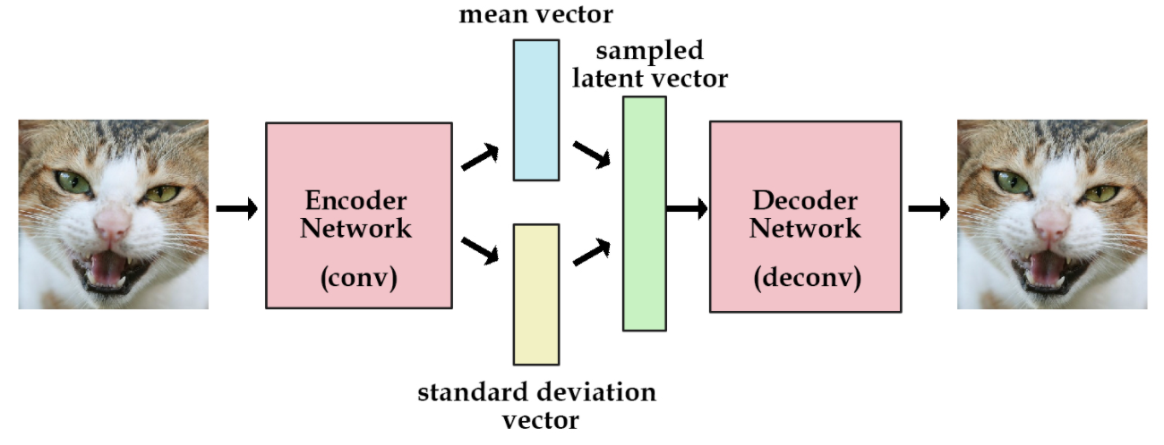
Lab Description - VAE
AE
VAE

Slide 7
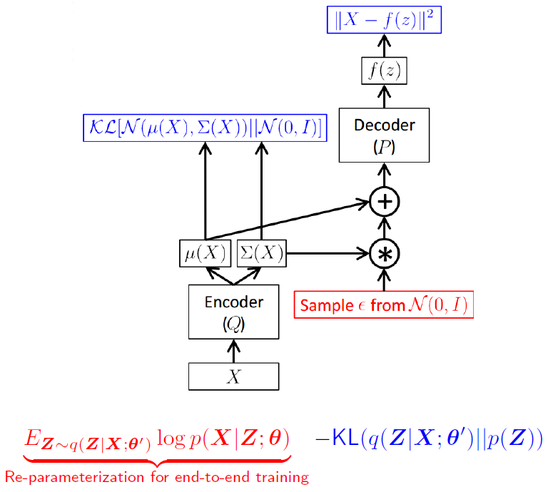
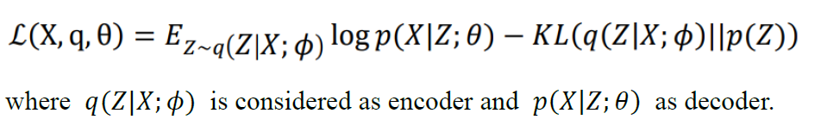
Lab Description – Reparameterization Trick
Log variance
Output should be log variance (not variance)

Slide 8
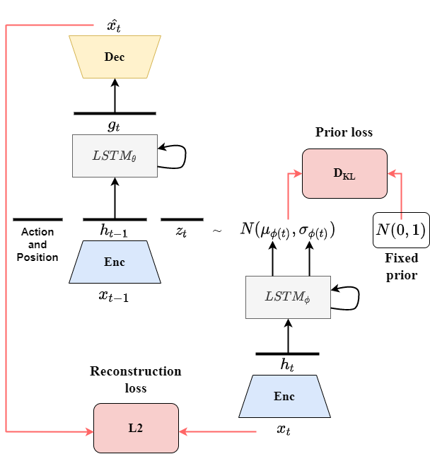
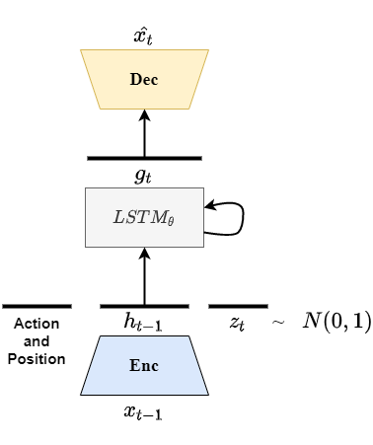
Lab Description – Overall architecture
(a) Training procedure
(b) generating procedure

Slide 9
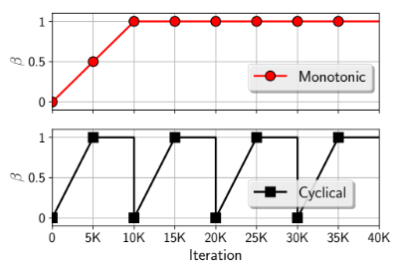
Lab Description - KL Cost Annealing
Initially set your KL weight to 0
Maximum value is 1

Slide 10
Lab Description - Dataset
We use bair robot pushing small dataset to train CVAE
This data set contains roughly 44,000 sequences of robot pushing motions, and each sequence include 30 frames

Slide 11
Lab Description – Get dataset
For Linux
For Windows
Click the following link and download it: https://reurl.cc/GoyZGd
pip install gdown
gdown https://drive.google.com/uc?id=1t8iOfBUYDFQH65RNWIgsEYenAo-HktAu
unzip processed data.zip

Slide 12
Lab Description – Other details
Adopt PSNR to evaluate the perceptual quality.
Provide in the sample (finn_eval_seq)
Given two past frame to prediction next ten frames (average PSNR)

Slide 13
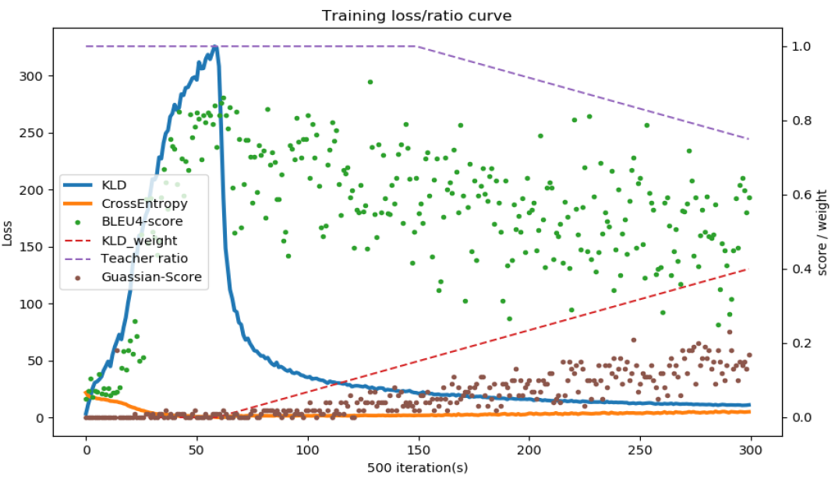
Lab Description – Requirements
Modify encoder, decoder, and training functions
Implement dataloader, and reparameterization trick.
Adopt teacher-forcing and KL loss annealing in your training processing.
Plot the losses, average PSNR and ratios.

Slide 14
Lab Description – Requirements
Make videos or gif images for test result (select one sequence)
Output the prediction at each time step (select one sequence)

Slide 15
Lab Description – Hints
Warning: You need to do the lab as early as possible because you may take more than two days to train the model
Model weights
Strongly recommend you save your model weights during training
Teacher forcing ratio and KL weight
Influential to the performance of model
You can first set your KL weight to 0 to see whether your model works.

Slide 16
Scoring Criteria - Report (60%)
Introduction(5%)
Derivation of CVAE(10%)
Implementation details(15%)
Describe how you implement your model. (e.g. dataloader, encoder, decoder, etc)
Describe the teacher forcing (including main idea, benefits and drawbacks) Notice: You must prove that you use previous predicted frame to predict next frame, i.e. teacher forcing ratio = 0 when testing (paste/screenshot your code)

Slide 17
Scoring Criteria - Report (60%)
Results and discussion(30%)
Show your results of video prediction
Make videos or gif images for test result (5%)
Output the prediction at each time step (5%)
Plot the losses, average PSNR and ratios. (5%)
Discuss the results according to your settings. (15%) Notice: This part mainly focuses on your discussion, if you simply just paste your results, you will get a low score

Slide 18
Scoring Criteria - Demo(50%)
Capability of video prediction.(20%)
Your model should use two past frames to predict the next ten frames
PSNR >= 25 ---- 100%
25 > PSNR >= 24 ---- 90%
24 > PSNR >= 23 ---- 80%
23 > PSNR >= 22 ---- 70%
22 > PSNR >= 21 ---- 60%
21 > PSNR >= 20 ---- 50%
PSNR < 20 ---- 0%
Questions (20%)

Slide 19
Scoring Criteria – Extra(30%)
Implement learned prior(10%)
Implement hierarchical structure(10%)
Implement conditional convolution(10%)

Slide 20
Reference
Yoojin Choi, Mostafa El-Khamy, and Jungwon Lee. Variable Rate Deep Image Compression With a Conditional Autoencoder. arXiv e-prints, page arXiv:1909.04802, Sept. 2019.
Emily Denton and Rob Fergus. Stochastic video generation with a learned prior. CoRR, abs/1802.07687, 2018.
Zhihui Lin, Chun Yuan, and Maomao Li. Haf-svg: Hierarchical stochastic video generation with aligned features. In Christian Bessiere, editor, Proceedings of the Twenty-Ninth International Joint Conference on Artificial Intelligence, IJCAI-20, pages 991–997. International Joint Conferences on Artificial Intelligence Organization, 7 2020. Main track.

